Slide 1
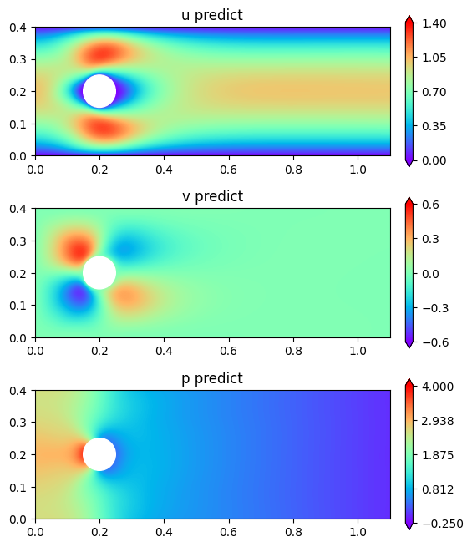
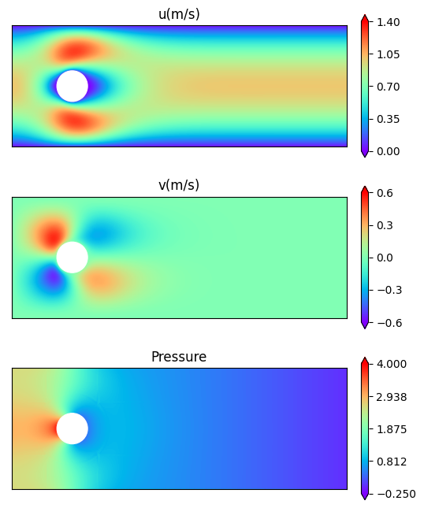
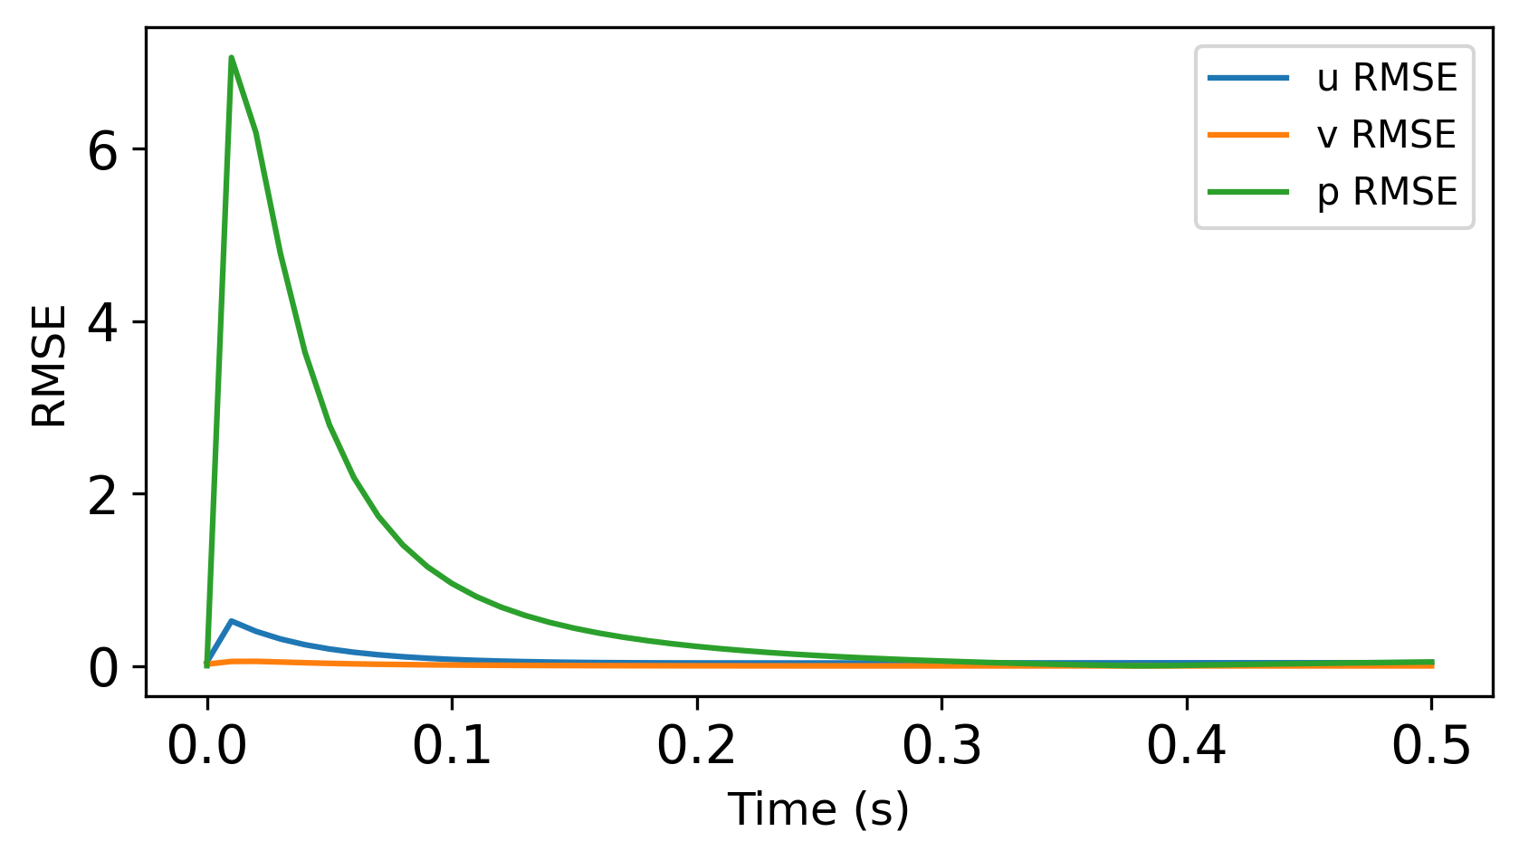
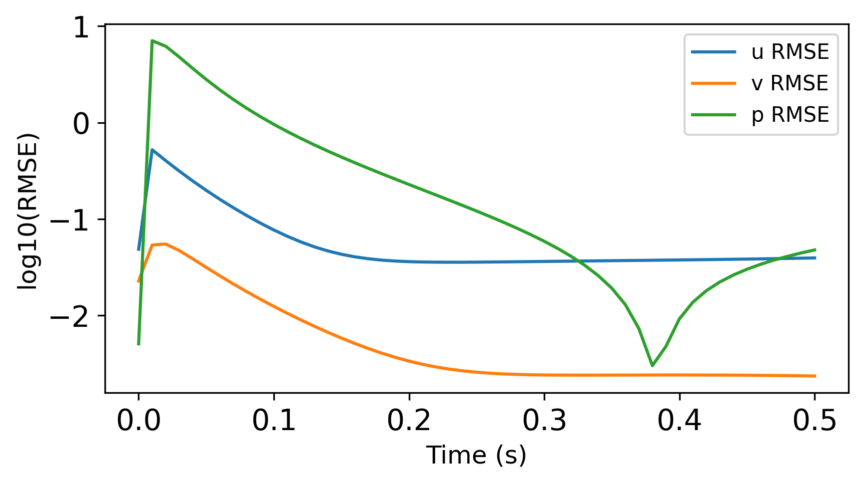
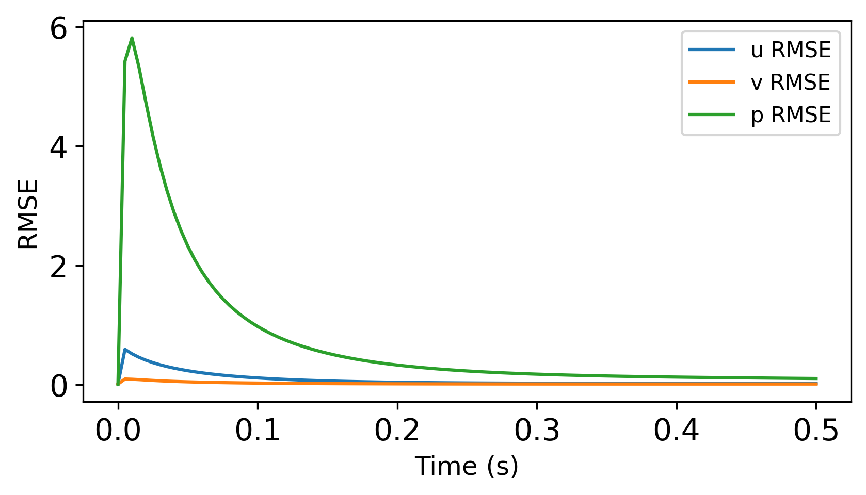
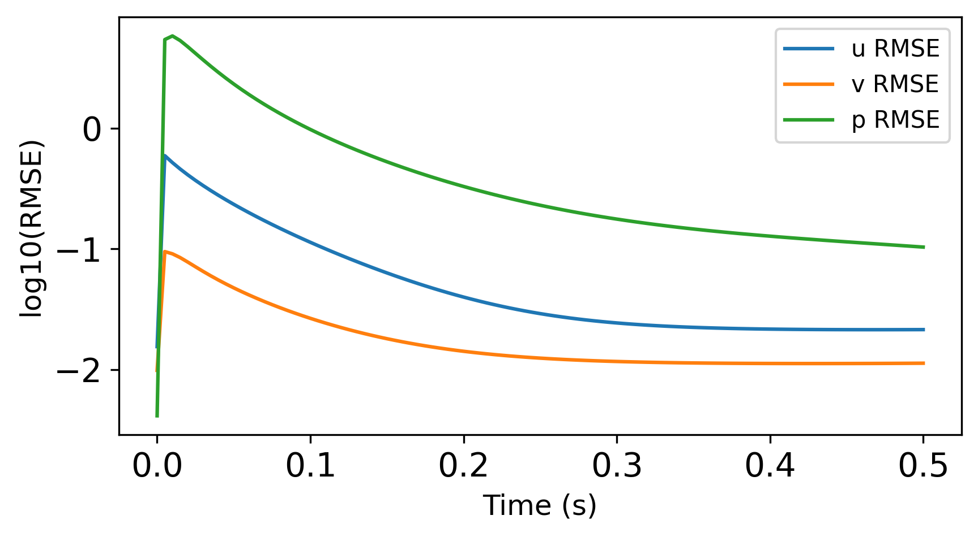
Sycamore implementation of examples
(a) Steady state analysis of laminar flow on a cylinder
(b) Transient analysis of laminar for on an open channel
(c) Transient analysis of laminar flow on a cylinder
Sycamore
OpenFOAM
Sycamore
OpenFOAM
Sycamore
OpenFOAM

